Slide 1

NDMA CUAS Specialist Course – Routine Maintenance

Slide 2
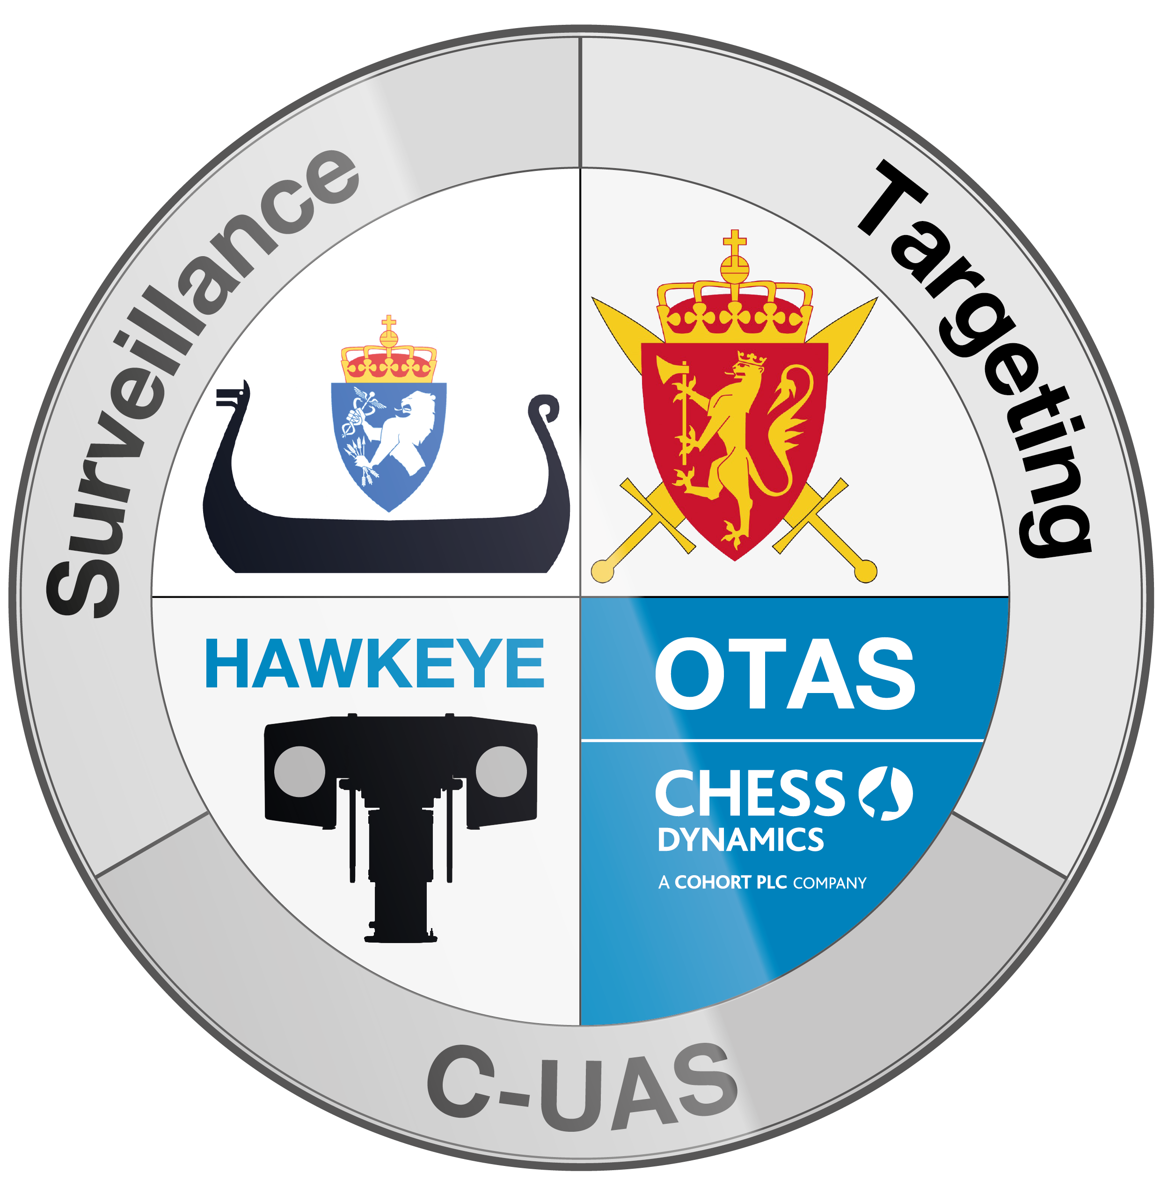
Routine Maintenance - Safety
⚠️
Prior to any maintenance being carried out, ensure the following:
The system is powered down
System is placed securely
Other personnel are aware of work being performed to prevent accidental activation of the system
Notes:
EO camera, Thermal camera, LRF
Desiccator – prevents moisture getting into the system

Slide 3
Routine Maintenance
Before carrying out any maintenance, either routine or corrective, the system must be cleaned to prevent ingress of dirt and debris.
Clean the system in the following way:
Remove any loose dust and dirt with a soft cloth.
Remove grime with a soft cloth moistened with dilute detergent or proprietary cleaning solution.
Remove any spillages from the system immediately.
Notes:
EO camera, Thermal camera, LRF.
Ensure no strong solvents used on lens.
Desiccator – indicates moisture getting into the system
Do not use water jet

Slide 4
Routine Maintenance – Deployment Checks
Mechanical Checks
Once system has been delivered to location, a number or mechanical checks should be performed.
Visual check of the equipment, especially camera lenses.
Clean as necessary.
Check colour of desiccator windows.
Check the condition of all of the external cables and their back shells.
Check connections are secure and correctly seated
Repair or replace damaged cable sheathes as appropriate.
Check the security of all fastenings and tighten as required.
Check mast for signs of wear or damage.
Check Fire extinguishers are in service date
Notes:
EO camera, Thermal camera, LRF
Add threadlock if repeatedly getting loose screws/bolts
Desiccator – indicates moisture getting into the system. Blue = good, pink = bad.

Slide 5
Routine Maintenance – Deployment Checks
Operational Checks
Prior to the system being utilised, a number of operational checks should be performed.
The system powers on and boots as required.
Check no breakers have tripped on the Rack Junction Box (RJB).
Images visible from both cameras (Daylight TV and Thermal).
The GPS has picked up current location information.
Radars power up and start scanning.
All system components show a “Green” healthy status in the VMS.
System moves when commanded via the control pad.
Check Digital Cross Hair Alignment (to be covered in another chapter)
Check Image Fusion alignment (to be covered in another chapter)

Slide 6
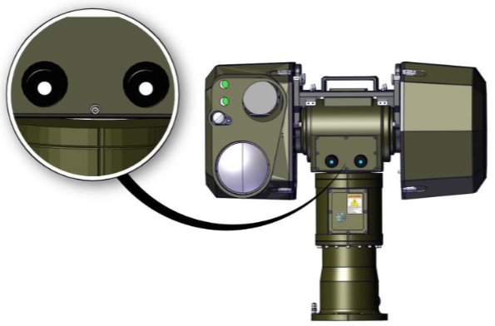
Routine Maintenance - Daily
Visual check of the equipment, especially camera lenses.
Wipe lenses as necessary.
Check colour of desiccator windows.
  On EOD, Tecnobit Camera and LRF
  On Tecnobit and EOD if both sides of the indicator have gone pink then the desiccator should be replaced
  On LRF desiccator should be replaced once every three years
Notes:
Desiccator – indicates moisture getting into the system. Blue = good, Pink = bad

Slide 7
Routine Maintenance – Monthly
These checks should be carried out on a weekly basis to ensure continued successful operation of the system
Check the condition of all of the external cables and their back shells.
Repair or replace damaged cable sheathes as appropriate.
Check whether any of the jam nuts on the connectors are loose, tighten if necessary.
Check the security and torque of all fastenings and tighten as required.
Check mast for signs of wear or damage.
Check Camera Alignment

Slide 8
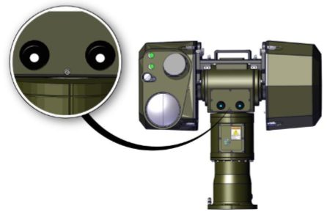
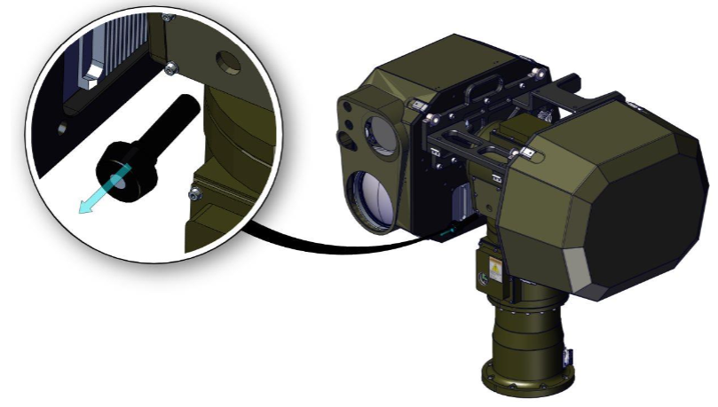
Routine Maintenance – Desiccator Replacement EOD/Tecnobit Camera
WARNING: All power must be removed from the system before starting this procedure.
Tools and consumables
18397–Desiccator BLD2233-19 M20 silica gel
Replacement procedure
Check the indicator on the front of the desiccator and if both 30 and 50 sides of the indicator have gone pink then the desiccator should be replaced.
Unscrew the desiccator from the EOD/Camera by gripping the plastic weather shield and rotating anti clockwise. Clean the exposed sealing face on the EOD/Camera.
Remove the new desiccator from its packaging and check there is an O-ring fitted on the back of the desiccator. Screw the desiccator into the EOD/Camera by gripping the plastic weather shield and rotating clockwise. Tighten down, compressing the O-ring onto the sealing face.
Never leave the EOD/Camera without a desiccator fitted as this may damage the equipment

Slide 9
Routine Maintenance – Desiccator Replacement LRF
WARNING: All power must be removed from the system before starting this procedure. Only use desiccators supplied and approved by Chess Dynamics. Do not use dry nitrogen to purge the LP17D.
Tools and consumables
Spanner, purge valve cap
Purge valve adaptor
Pressure regulated, dry, synthetic air with a dew point of -70 °C
New replacement desiccator
Replacement procedure
Remove the protective cap from the purge valve and fit the purge valve adaptor to the LP17D.
Pressurize the system to 225±7.5 mmHg with dry synthetic air.
Remove the desiccator holder from the LP17D.
Let the dry synthetic air escape through the desiccator membrane and keep the air flowing for at least 10 minutes.
Prepare the new desiccant holder by removing the protective cap from the holder.
Keep the system under pressure while replacing the desiccator.
Remove the purge valve adaptor and replace the purge valve protective cap.
Notes:
EO camera, Thermal camera, LRF
Desiccator – prevents moisture getting into the system. Blue = good, Pink = Bad

Slide 10
Routine Maintenance
Questions?

Slide 11
Routine Maintenance – Practical Session
Practical Session with the system
Understand system components
  Locations of fitment in vehicle
Deployment checks
Monthly system checks

